Slide 1
Telecom Customer Churn
Noah Scanlon

Slide 2
The Problem
Winning customers is hard, so retaining customers once won is important.
Reduce churn.

Slide 3
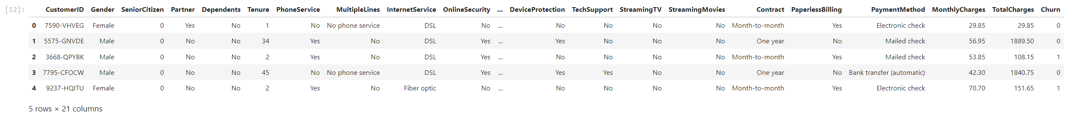
The Data
Customer ID (All unique)
Gender (M/F)
Tenure (In years)
Monthly Charges (In $)
Total Charges (In $)
Churn (Yes/No)

Slide 4
The Goals
Understand why customers are churning
Predict who will churn

Slide 5
Metrics of Success
Accuracy
%
Recall
tp / (tp + fn)

Slide 6
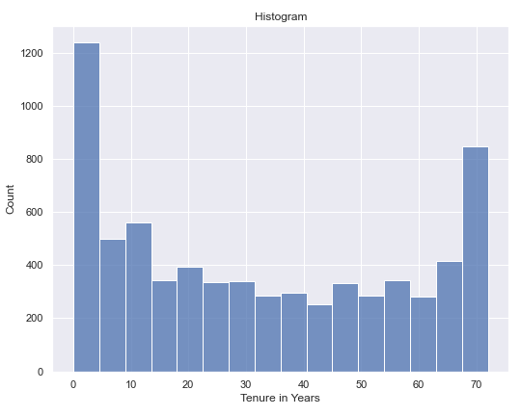
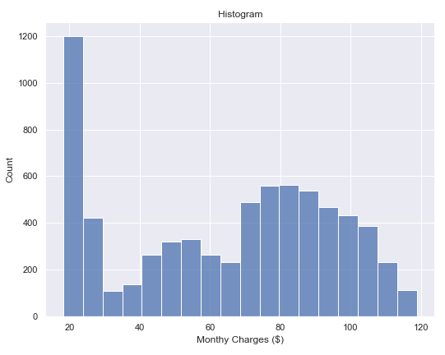
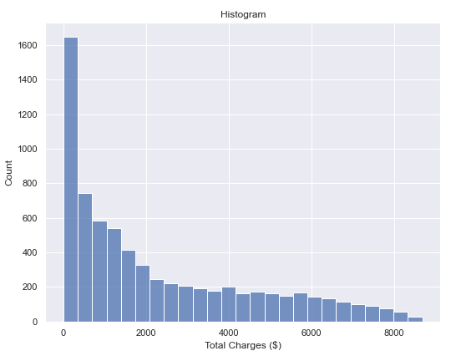
Feature Characteristics

Slide 7
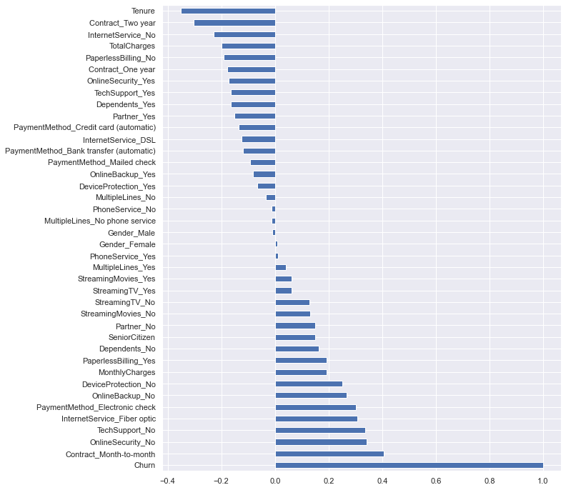
Churn Correlations
Tenure
No Internet
No Online Security
Month-to-Month Contracts

Slide 8
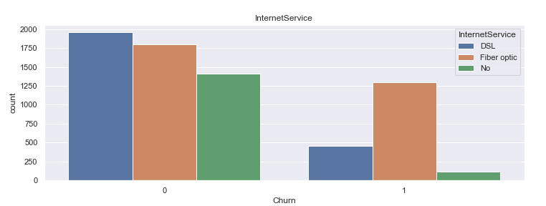
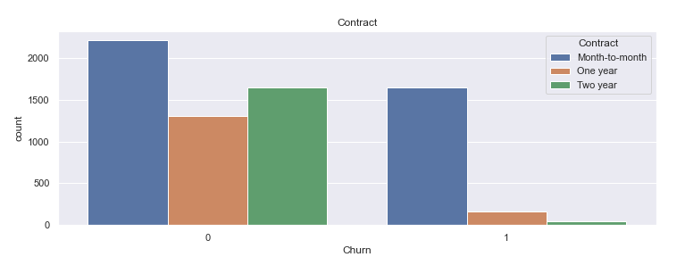
Highest Churners
Contract: Month-to-Month
Online-Security: No
Tech-Support: No
Internet Service: Fiber Optic
Payment Method: Electronic Check

Slide 9
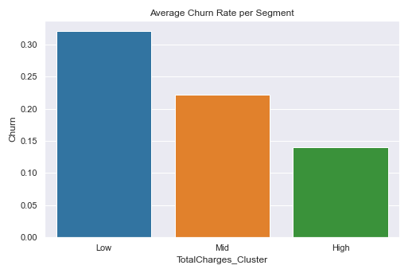
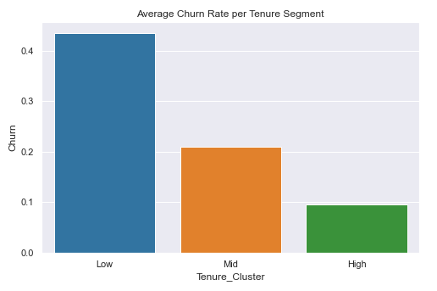
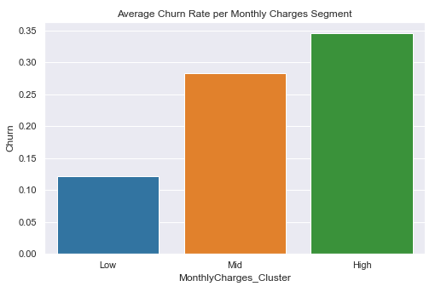
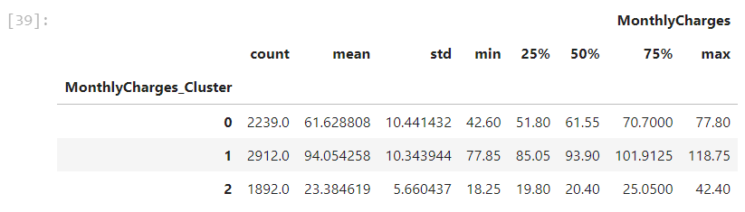
Customer Segmentation

Slide 10
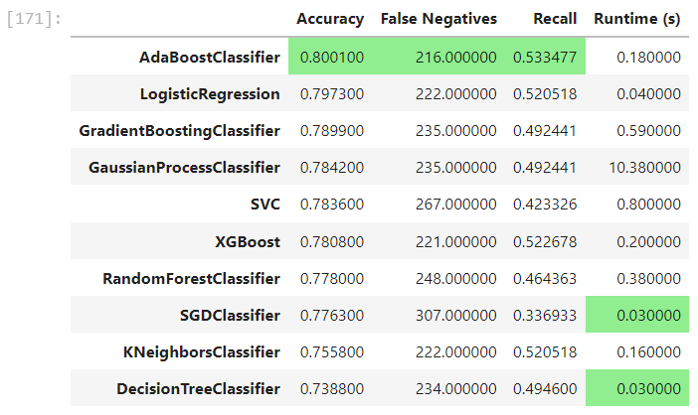
Model Exploration - Performances
These are untuned model performances
AdaBoost and Logistic Regression performed best

Slide 11
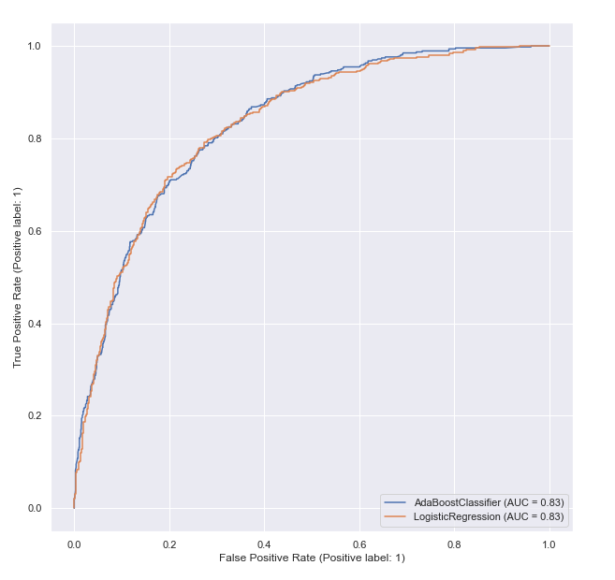
Model Refinement – HP Tuning
Grid-Search Cross-Validation
Recall Scores (1 is best, 0 is worst)
AdaBoost: 0.555
Logistic Regression: 0.553

Slide 12
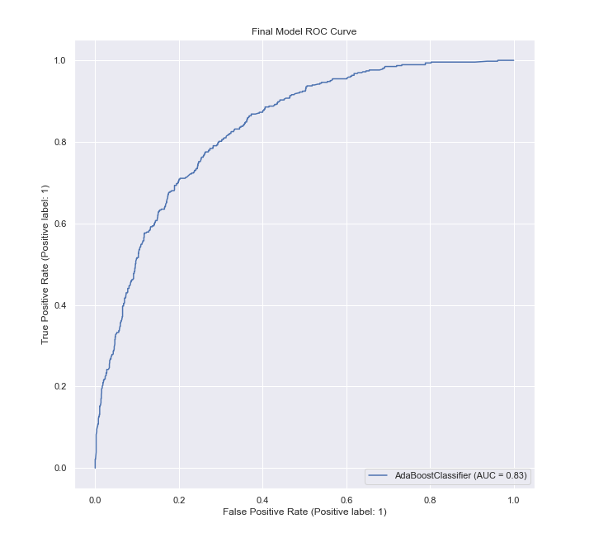
Final Model – Metrics
Accuracy: 0.8001
Recall: 0.5335
False Negatives: 216 / 7043 or 3%
AUC: 0.83

Slide 13
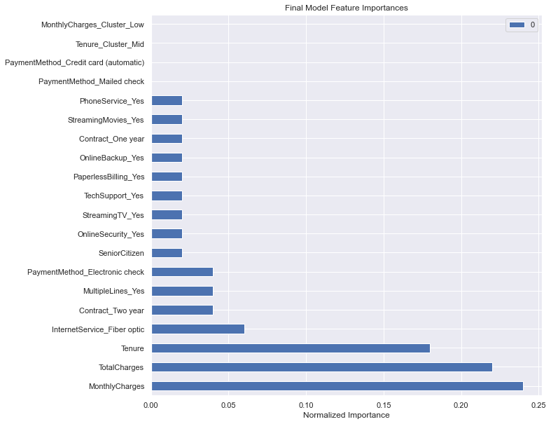
Final Model – Interpretation
Monthly Charges, Total Charges, and Tenure make up 65% of the predicting power

Slide 14
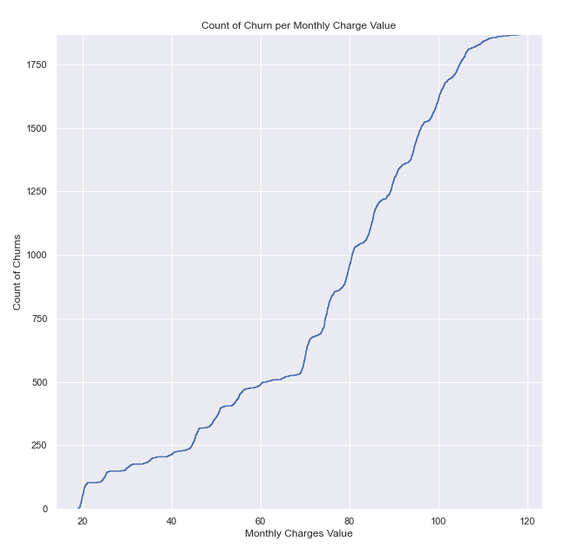
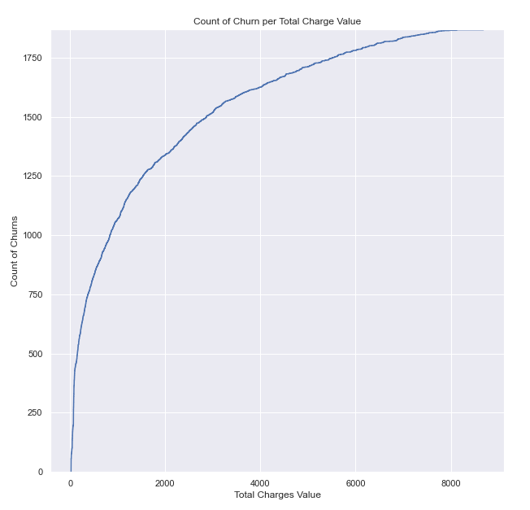
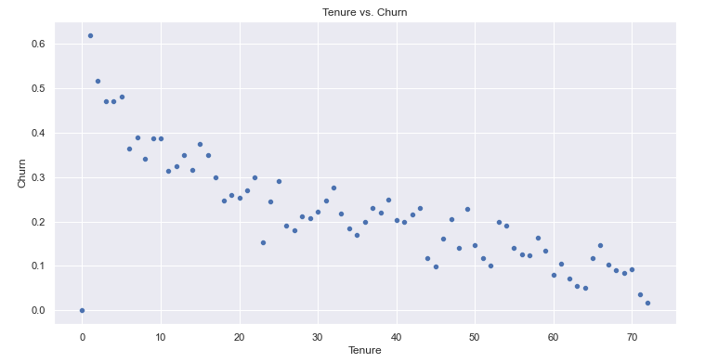
Final Model – Top 4 Features
Monthly Charges:
^ charges, more churn
Total Charges:
< $1,000 likely to churn,
~½ of churns
Tenure:
Less tenure, more churn
Internet Service – Fiber Optic:
Highest in category

Slide 15
How to Use the Findings
As the business, act on these predictions and try to retain the customers predicted to churn!
Reduce monthly charge rates
Incentivize customers with total costs below $1,000 / year to commit to more offerings
Focus on first 5 year customers especially, after that the likelihood to churn calms
Figure out what is happening with fiber optic internet service!

